Slide 1
Service Fabric
Cloud Native Microservices

Slide 2

What is Service Fabric?
Middleware platform for building and managing enterprise-class, Tier-1 cloud-scale applications
Simplifies packaging, deploying, and managing scalable microservices
Enterprise grade container orchestrator for both Windows and Linux containers
Designed to be scalable, reliable, and manageable
Designed to allow developers and administrators to avoid solving complex infrastructure problems and focus on implementing mission-critical, demanding workloads
Notes:
High scale, flagship products for our customers
Flexible and powerful – host apps, containers, guest exes
Solves scale and density issues
Complex, especially initially
IT, Developers, Devops, security
Extremely well documented (1300 pages)
Extremely high number of cores for both internal and external

Slide 3
Azure Service Fabric: Microservices platform
Build, deploy, and operate applications as microservices, using any OS, at any scale, on any cloud
Build
Deploy
Operate
Build new or modernize existing applications
Deploy, run and orchestrate any code including containers
Manage and secure applications reliably at any scale

Slide 4
To build, deploy, and operate…
…containers or microservices on any OS on any cloud
Programming Models
Dev & Ops Tooling
Orchestration
Lifecycle Management
Health &
Monitoring
Always On Availability
Auto
Scaling
Dev machine
Azure
On-premises infrastructure
Including Azure Stack
Other clouds

Slide 5
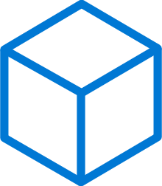
Build: data-aware microservices
Programming Models
Dev & Ops Tooling
Orchestration
Lifecycle Management
Health &
Monitoring
Always On Availability
Auto
Scaling
Lifecycle Management
Always On Availability
Orchestration
Programming
Models
Health &
Monitoring
Dev & Ops
Tooling
Auto
Scaling
</>
Reliable Actors
Reliable Services
Guest Executables
Containers
.NET, or Java
Maximize uptime and scalability with stateful and stateless Actors
Manage state reliability without a database, lowering latency. Use stateless services to write data to eternal data stores
Run any existing code
Orchestrate your Windows Server or Linux containers reliably at scale
Best platform for .NET and ASP.NET core with Visual Studio 2017 and Java using Eclipse and Jenkins

Slide 6
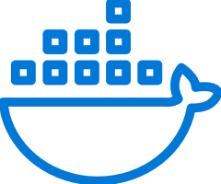


Deploy: any code on any OS
Programming Models
Dev & Ops Tooling
Orchestration
Lifecycle Management
Health &
Monitoring
Always On Availability
Auto
Scaling
Lifecycle Management
Always On Availability
Orchestration
Programming
Models
Health &
Monitoring
Dev & Ops
Tooling
Auto
Scaling
CI/CD
Docker Compose and
Azure Container Instance
Automate
Rolling upgrades
Monitor and diagnose
Use familiar tools: Visual Studio + Team Services for .NET or Jenkins + Yeomen for Java
Deploy or remove applications using PowerShell, CLI, Visual Studio, and other APIs
Upgrade non-disruptively and roll-back in case of failures, automate with PowerShell
Generate, aggregate, and analyze events with built-in tooling and integration with Azure services such as AppInsights and OMS
Orchestrate existing container applications or deploy single containers

Slide 7
Operate: on any cloud at any scale
Programming Models
Dev & Ops Tooling
Orchestration
Lifecycle Management
Health &
Monitoring
Always On Availability
Auto
Scaling
Lifecycle Management
Always On Availability
Orchestration
Programming
Models
Health &
Monitoring
Dev & Ops
Tooling
Auto
Scaling
Use familiar tools
Use controlled chaos
Recover gracefully
Secure at scale
Automated Platform Upgrades
Such as Splunk, OMS, ELK, or AppInsights to gain deep insights or monitor application health
Test graceful and ungraceful failure scenarios
Recover from machine or service failure gracefully; replicate data automatically
Secure node-to-node communication and management access
Service Fabric runtime and OS upgrades are automated for you or can choose to schedule them

Slide 8


When and Why would you use Azure Service Fabric?

Slide 9
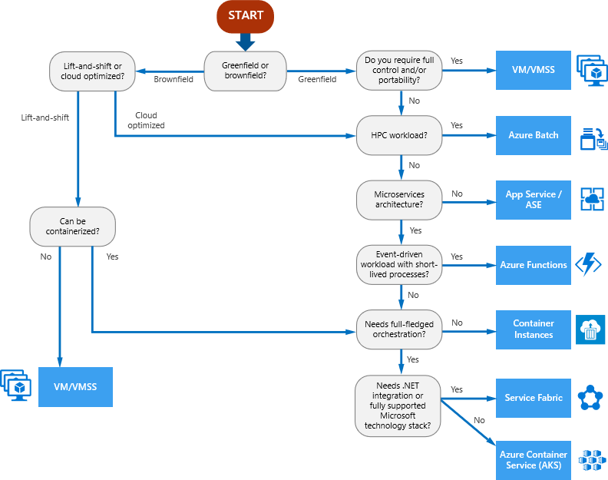
Compute Decision Tree
Compute Services covered:
VM
VMSS
Azure Batch
App Service
App Service Environment
Azure Functions
Container Instances
Service Fabric
Azure Kubernetes Service

Slide 10
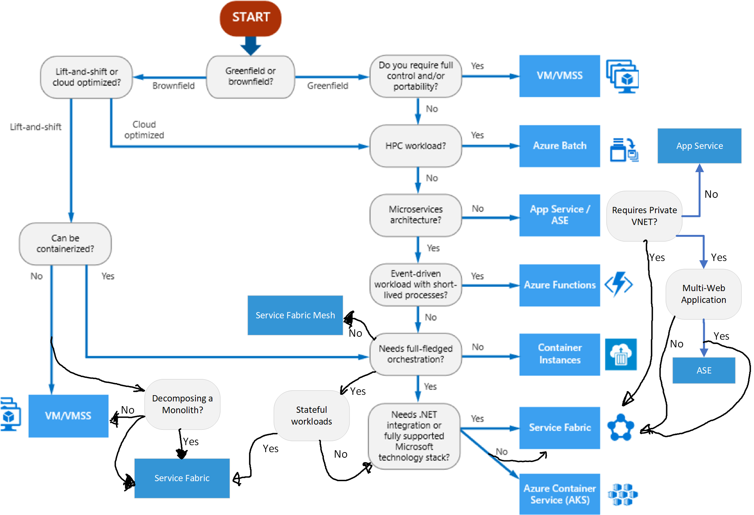
Compute Decision Tree v2
Notes:
The point here is that simplifying our decision tree is hard in a complex, quickly changing environment.

Slide 11





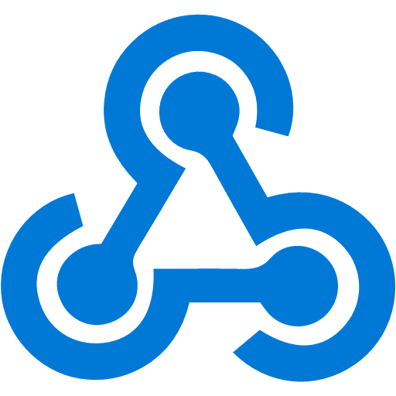




Scenarios powered by Service Fabric
Empowering customers of all sizes to achieve more
Lift & shift including containers
Mission-critical business SaaS
Low-latency data processing apps
IoT data processing
New cloud-native apps
Artificial Intelligence Applications
Multi-tenant Applications
Enterprise Microservice / API Catalog
DevOps heavy applications

Slide 12
Scenarios powered by Service Fabric
Empowering customers of all sizes to achieve more
Lift & shift including containers
Mission-critical business SaaS
IoT data processing
Low-latency data processing apps
New cloud-native apps
Artificial Intelligence Applications
Multi-tenet Applications
Enterprise Microservice / API Catalog
DevOps heavy applications
Notes:
These are the ones we will focus on.

Slide 13





Lift and Shift (with and without Containers)
5 stages in a continuum…
1
2
3
4
5
Traditional application
Traditional application hosted as guest executables or containers
Traditional application + new microservices
Parts of existing traditional application extracted
New or transformed microservices application
... Service Fabric supports any stage you choose

Slide 14



Business Critical Applications
Customer Profile:
Microsoft has deep expertise in running global services such as Cortana, Skype & Cosmos DB
Service Fabric is the foundational technology powering these services & core Azure infra
Sample scale of one of these services: 60 billion events per day with millions of databases
About 30% of Azure’s cores run Service Fabric directly.
Service Fabric Manages Millions of Service upgrades weekly within Microsoft alone
May 23, 2018 – 2.0066 Trillion requests to Azure Event Hubs (from Dan Rosanova via Twitter)
SQL Database
SQL
Power BI
{ }
Cosmos DB
Dynamics
IoT Hub
Intune
Event Hub
Cortana
Skype
Designed for mission critical tier 1 workloads
Notes:
Dan Rosanova - 2.0066 TRILLION requests to #AzureEventHubs on May 23 2018. That’s some scale! @Azure

Slide 15
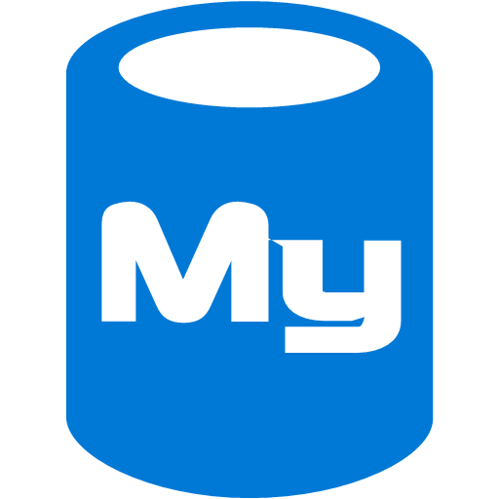











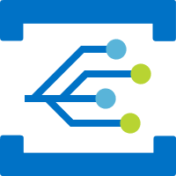




Business critical application customer use cases
Azure Database for MySQL
Azure Database for PostgreSQL
Azure Monitor
Azure Container Registry
Core Azure Services
Archive Storage
Event Grid
Azure Networking
Stream Analytics

Slide 16

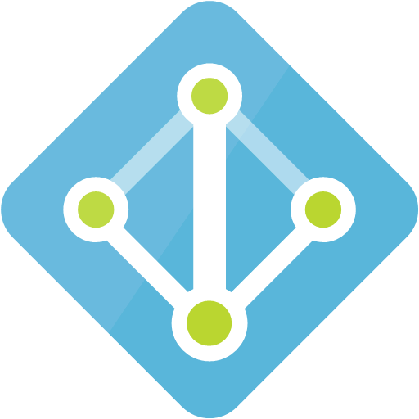
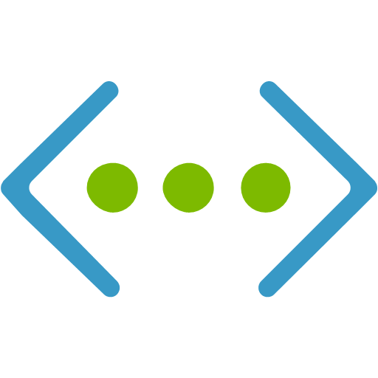
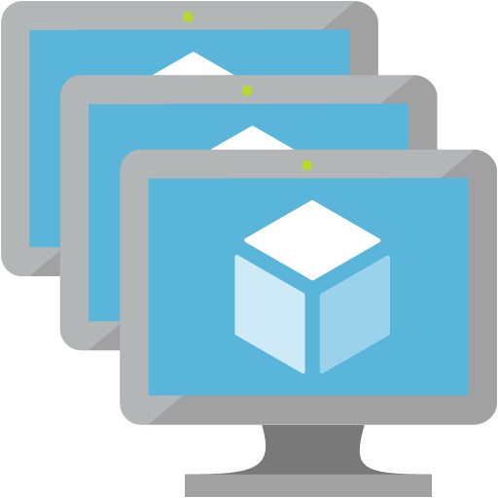
Enterprise Microservice & API Catalog
API Management
Service Fabric Cluster
API Management & SF on the same VNET
Internal & Externally based API users (devs)
APIM native integration with SF (no LB)
Density on the VMSS
Stateful, Stateless, Container based APIs on SF
Extremely rich ASP.Net Core Stateful services
Azure AD
VNET
VMSS
Notes:
https://docs.microsoft.com/en-us/azure/service-fabric/service-fabric-api-management-overview

Slide 17
DevOps Heavy Applications
Cross cutting concern, can be across all of the previously mentioned workloads
SF is agnostic to the CICD technology
Several release options (Rolling upgrade, VIP Swap, Controlled migration, etc)
Service Fabric handles the runtime and underlying resource updates
Mr. Donovan Brown: #RubDevOpsOnIt
Notes:
#RubDevOpsOnIt

Slide 18



Key Service Fabric DevOps Features
Service Affinity
Node Placement
Multi-version, Blue-Green
Chaos testing
Open REST API, PowerShell, CLI
TrafficManager
Azure LB / AppGateway
Notes:
Top pic– Service Affinity
Left bottom – node placement
Bottom right – blue green

Slide 19
Service Fabric Build and Release Pipeline Example
Repo
Build
Restore
Build
Package
Publish Artifacts
Release
Deploy
Unit Tests
Run tests
Approve
Environment A
Environment B
Deploy
Run tests
Approve
Commit
Update Versions

Slide 20
Publish a Service Fabric Application
Copy Application Package
Register Application
Create Named Application
Application Instance
Application Type and Version
PowerShell and Runtime (FabricClient.ApplicationManagementClient)
SDK → Publish-NewServiceFabricApplication.ps1
Visual Studio Project → Deploy-FabricApplication.ps1
Visual Studio Team Services → Deploy Service Fabric Application

Slide 21


Chaos Testing
Netflix and AWS
Built into service fabric
Generates faults to exercise the cluster
Restart a node
Restart a deployed code package
Remove a replica
Restart a replica
Move a primary replica
Move a secondary replica
Highly configurable
Run from C# or PowerShell
Notes:
https://azure.microsoft.com/en-us/documentation/articles/service-fabric-controlled-chaos/

Slide 22
Cluster Upgrade Options
 | Delete & Upload | Rolling Upgrade | VIP Swap | Controlled Migration
Add’l Hardware Costs | None | None | 2x | 1x to 2x
Service availability | Downtime | Reduced scale | Same | Same
Failed upgrade recovery | Downtime until V1 upload | Reduced scale until rollback | Immediate after swap back | Immediate after TM reconfig
V2 testability | Not at all | Not at all | Private & Public | Private & Public
Protocol/Schema change | 1-Phase | 2-Phase | 1-Phase | 1-Phase
Usable with stateful services | No | Yes | No | No
Some upgrades can be done 1 way and other upgrades another way

Slide 23

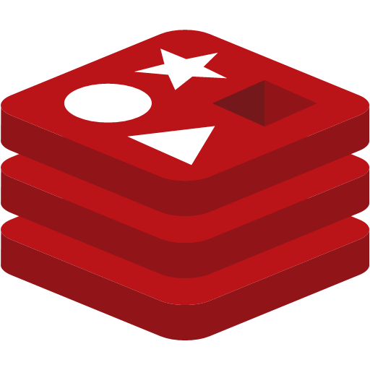




Other services that compliment SF
Gateways: IOT Hub, Event Hub, API Management, Azure Load Balancer, AppGateway
Messaging: Service Bus, Event Hub, IOT Hub, Stream Analytics
Persistent Storage: Redis Service(cache), CosmosDB, SQL Azure DB, Azure Database for MySQL, Azure Database for PostGRES, Azure Data Lake Storage
Web front end: App Services, App Service Environment
Bursting workloads: Azure Functions
Integration: Azure Logic Apps
Reverse Proxy: Traefic, Envoy
Monitoring: OMS, Application Insights
Networking / Traffic management: Traffic Manager, Load Balancer, AppGateway

Slide 24

.Net Microservices

Slide 25
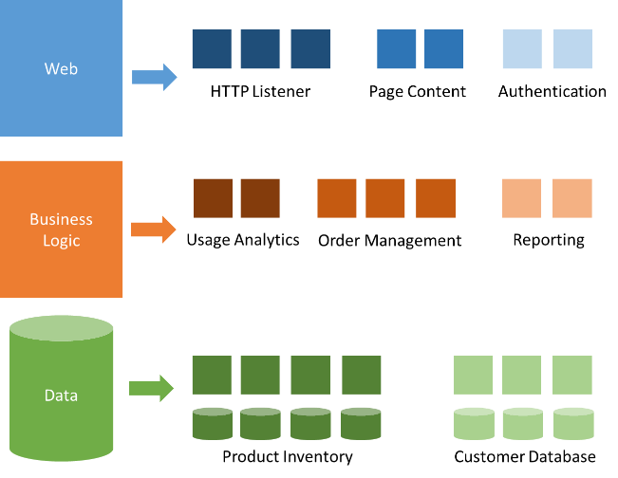
Microservices Lightning Fast Refresher
Small, autonomous services
Self Contained – single work unit
Loosely coupled
Independent deployments
Persist their own data
Communicate via API
Can be independent tech stacks
Containers != Microservices
SOA != Microservices
Distributed Object Oriented Programming

Slide 26
Distributed System Architecture Best Practices
Design for self healing
Make all things redundant - avoid having single points of failure
Minimize coordination between application services to achieve scalability
Design to scale out - scale horizontally, adding or removing as demand requires
Partition around limits - to work around database, network, and compute limits.
Design for operations – use the right tools for the operations team
Use managed services - use PaaS rather than IaaS
Use the best data store for the job
Design for evolution - change is key for continuous innovation
Build for the needs of business
Notes:
These are actually real ☺
https://docs.microsoft.com/en-us/azure/architecture/guide/design-principles/
So what is the problem – this is hard.
SF is great at this and can help

Slide 27

An easier, battle-tested approach
Rolling Upgrades
Availability Guarantees
Scale Out Architecture
Resource Governance
Density
Packaging & Deployment
Policy Enforcement
Granular Versioning
Stateful Workloads
Leader Election
Service Fabric

Slide 28
Service Fabric is the best choice for .Net microservices and Windows Container orchestration
Microservices
Windows Containers
Notes:
Be clear here – SF is agnostic and has support across so many areas. It stands out as a .Net microservices and Windows container orchestrator

Slide 29
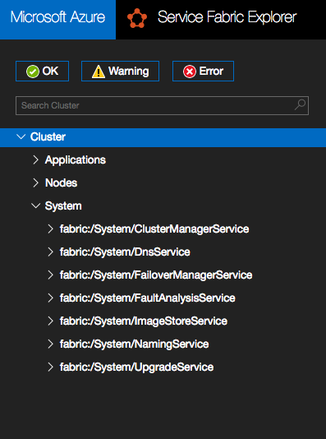
Service Fabric Microservice Architecture
Service Fabric is a microservices based platform
Developer support - deep Visual Studio integration
Local IDE Debugging
Local Cluster support
Log Streaming via Cloud Explorer
Project Templates
Deployment from Visual Studio
VSTS pipeline integration
Container, Guest Exe, Microservices model mixing
Additional programming models like Reliable Actors
Notes:
Right illustration is the system services – here is what they do:
Cluster Resource Manager - Cluster and resource management
Failover Manager- Rebalances service instances as nodes come/go
Naming - Registry mapping service instances → endpoints
Fault Analysis - Let’s you inject faults to test your services
Image Store- Contains your app packages
Upgrade - Upgrades Service Fabric on nodes (Azure only)
DNS - Used for containers in conjunction with the naming service for service discovery

Slide 30
Windows Containers
Only orchestrator with Native Support for Windows Containers
Docker Compose, JSON (ARM)
Visual Studio tooling, templates, debugging
Resource Governance
Windows Server Containers and Hyper-V Containers
IP per Container, Container Groups, VPN Per App
Stateful containers
Service Fabric local storage volume driver
Dynamic Placement, Load Balancing, DNS
Notes:
Kubernetes has windows support but is in beta
Resource Goverance:
MemorySwapInMB: The amount of swap memory that a container can use.
MemoryReservationInMB: The soft limit for memory governance that is enforced only when memory contention is detected on the node.
CpuPercent: The percentage of CPU that the container can use. If CPU limits are specified for the service package, this parameter is effectively ignored.
MaximumIOps: The maximum IOPS that a container can use (read and write).
MaximumIOBytesps: The maximum IO (bytes per second) that a container can use (read and write).
BlockIOWeight: The block IO weight for relative to other containers.
<Application Name="fabric:/TestApplication1" xmlns="http://schemas.microsoft.com/2011/01/fabric"> <Parameters> <Parameter Name="CpuCores" DefaultValue="2" /> <Parameter Name="CpuSharesA" DefaultValue="512" /> <Parameter Name="CpuSharesB" DefaultValue="512" /> <Parameter Name="MemoryA" DefaultValue="1024" /> <Parameter Name="MemoryB" DefaultValue="1024" /> </Parameters> </Application>
https://docs.microsoft.com/en-us/azure/service-fabric/service-fabric-resource-governance

Slide 31


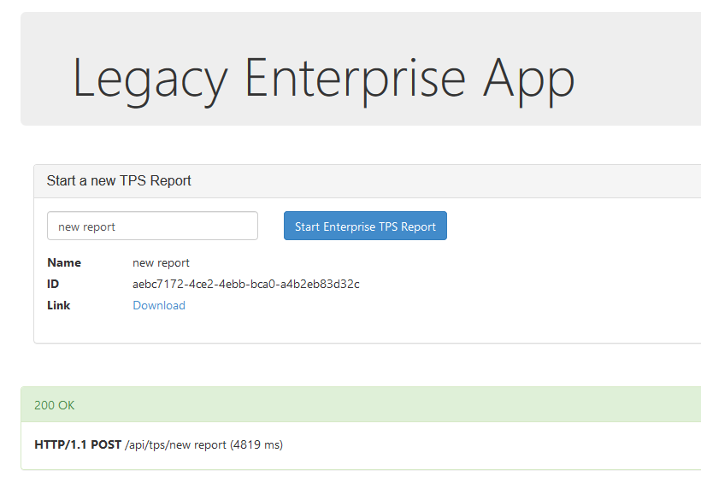

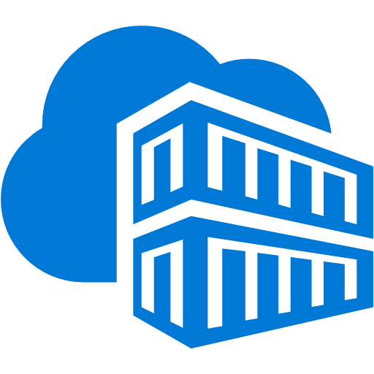

“Lift and Shift” existing applications to containers
Service Fabric cluster
Service Fabric Application Model or
Docker Compose
Front-end web service
container
Database Migration Service
VSTS Git Repository
Azure Container Registry
Application modernization with Microsoft Azure
Corey Sanders
SQL Server

Slide 32
















Stateless Services
Node Type – Front End
Native .Net Microservices (with and without containers)
Web Services
API Services
Worker Processes that are listening to a messaging bus
Transaction processing services
Independent scale
Independent deployments
High density
VMSS1
Node Type – Back End
VMSS2
Notes:
Demonstrating lots of concepts on the right:
2 node types on the same VNET but different subnets with NSGs restricting traffic between services
Each node type will have separate load balancers
Each node type will be an independent VMSS with different machine profiles
The service fabric services can run like this or in an independent 3rd node type marked as “primary”
Service definitions (all stateless microservices or containers):
Pine tree = -1 instances with node placement of “Front End”
Cow = 3 instances, node_type = “Front End”
Lock = -1 instances
Motorcycle = -1 instances with node_type = “Front End”
Football = 7 instances
Turtle = 1 instance
Labrador = -1 instances with node_type = “Back End”
Duck = -1 instances with node_type = “Back End”
Sun = 3 instances with node_type=“back end” with a Parent Affinity for the cloud service
Cloud = 3 instances with node_type = “back end” with a child affinity for the sun service
Rabbit = start with 1 container instance with autoscaling based on load with node_type = “back end”
https://docs.microsoft.com/en-us/azure/service-fabric/service-fabric-cluster-resource-manager-autoscaling

Slide 33
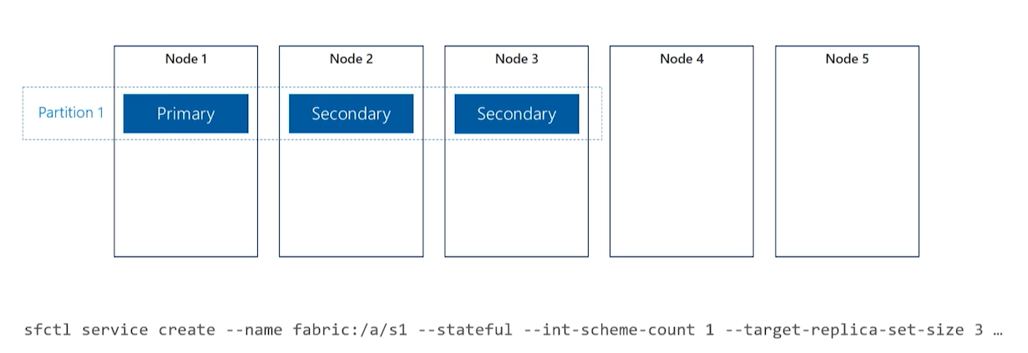
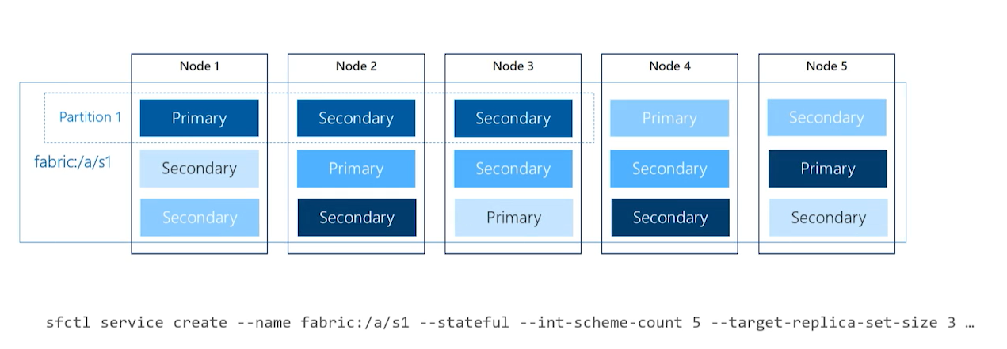
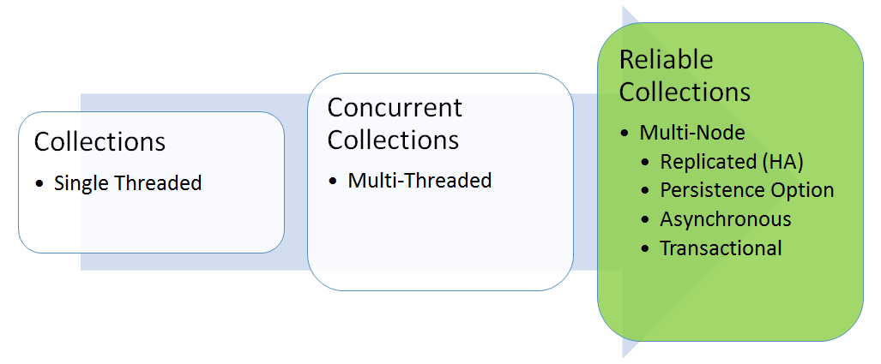
Stateful Services
Low latency reads and writes in native language
Built in partitioning and data replication
ASP.Net Core Stateful services
Caching layer without volatility
Pro tip: Data Contract Serialization
Architecture tip: Partition with backing data store
Moving to Nuget instead of SDK
Lots of options for programming (queues, dictionaries)
Notes:
https://github.com/jessebenson/azure-performance
The question is always how far do you go?

Slide 34


Service Fabric Roadmap + Service Fabric Mesh

Slide 35



Service Fabric is powerful
…. But it can be complex and the learning curve can be steep

Slide 36


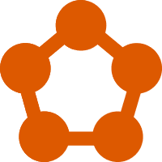
Azure Service Fabric Mesh
Dev machine
Any cloud
On-premises
Service Fabric Standalone
Azure
Service Fabric
Azure
Service Fabric Mesh
Bring your own infrastructure
Dedicated Azure clusters
Fully managed microservices platform
Service Fabric

Slide 37


Azure Service Fabric Mesh
A fully-managed microservices platform for business critical applications
Microservices development
Serverless infrastructure
Scale on demand
</>
.NET
</>
Lifecycle management
Pay only for what you use
Intelligent traffic routing
Microservice and container orchestration
Security & compliance
Health & monitoring
Notes:
Talk about service mesh

Slide 38


Service Fabric Mesh - Modernize
Deploy anything and everything in a container
Bring your own network to connect to other systems
No code changes required
No servers or VMs to manage with Service Fabric Mesh
COM
IIS
</>
NGINX
Service Fabric

Slide 39


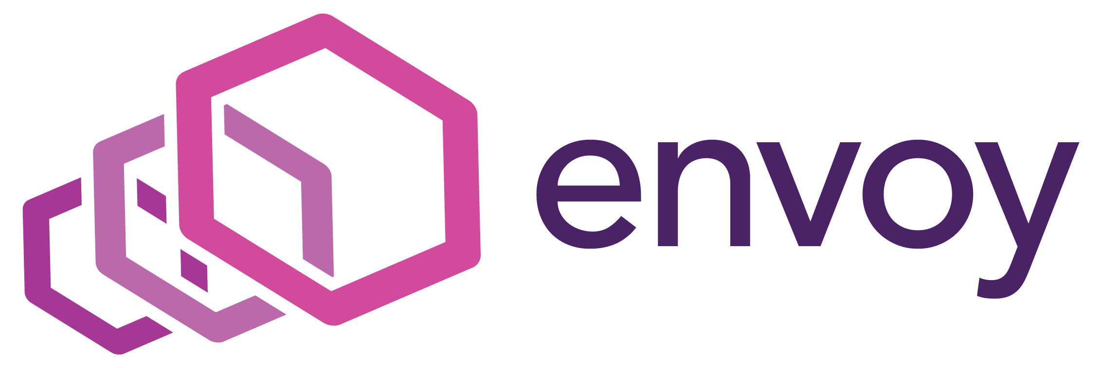
Service Fabric Mesh - Cloud-native
Any language, any framework
Service Fabric Libraries for multiple languages
Easy H/A state storage with Reliable Collections
Intelligent traffic routing and connectivity
ASP.NET Core
.NET
Go
C++
Service Fabric

Slide 40

How you write your applications
Simplicity
Portability
Docker Compose
Run Docker Compose workloads on Service Fabric
Limited Service Fabric integration
Portability for existing applications described by Docker Compose
Everything runs in containers
Local
Any cloud
On-prem
Azure
Service Fabric Resources
Loosely coupled individually deployable resources
Decoupled from runtime lifecycle
Universal model for any language, framework, or arbitrary application
Everything runs in containers
Local
Any cloud
On-prem
Azure
Mesh
Application and Service Manifest
Low-level control of Service Fabric platform primitives
.NET and Java frameworks tightly integrated with runtime lifecycle
Several different programming models
Allows processes or containers
Local
Any cloud
On-prem
Azure
Control
Integration

Slide 41
Service Fabric Mesh - Resources
A deployment model composed of individual resources.
Anything that can be deployed to Service Fabric is a resource.
Applications and Services
Networks
Secrets
Volumes
Routing rules
Auto-scale rules

Slide 42
Service Fabric Mesh Resources
Resources are described declaratively in YAML or JSON files.
Resources can be deployed anywhere Service Fabric runs.
Applications and Services
my-app.yaml
Networks
my-app-network.yaml
Secrets
my-secrets.yaml
Volumes
my-volume.yaml
Routing rules
my-routes.yaml
Auto-scale rules
my-autoscale-rules.yaml

Slide 43
Service Fabric Mesh Resources
Resources can be grouped together in an Azure Resource Manager template when deployed to Azure Service Fabric Mesh.
Applications and Services
Networks
Secrets
deployment.json
Volumes
Routing rules
Auto-scale rules

Slide 44
Service Fabric Mesh Resources
Any language, any framework
No Service Fabric frameworks or base classes. Just containers.
Service Fabric libraries provide integration with the Service Fabric environment.
.NET Core
Java
Node.js
Python
Ruby
Go
C++
Tomcat/IIS/NGINX
PHP
Service Fabric Libraries
Reliable Collections
Local H/A storage for ASP.NET Core
SF API Client
Container

Slide 45

Service Fabric Mesh - Secrets Resource
Inline or stored in Azure Key Vault
Applications and service resources have Managed Service Identity (MSI) with AAD to be able to access secrets in Azure Key Vault
Secrets and certificates can be auto-rolled over with policies
Service
Secret

Slide 46
Service Fabric Mesh - Volume Resource
General-purpose file storage
Read and write files using normal disk I/O file APIs.
Backed by Azure File storage or Service Fabric Volume disk
Service
Service Fabric Volume disk
Azure File storage
Volume
Replicated local disk
Network storage
Notes:
Try this today!
http://aka.ms/sf-filesvolumedriver

Slide 47
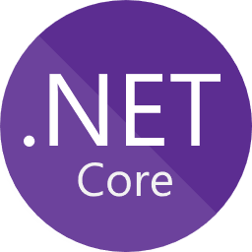


Service Fabric - Diagnostics and Monitoring
Containers write stdout/stderr logs to volumes
Azure Application Insights integration for .NET
Azure Monitor for platform events and container metrics
Service
stdout/stderr
Container
Volume
AppInsights SDK
.NET
Azure Application Insights
Platform events & metrics
Service Fabric
Azure Monitor

Slide 48
Service Fabric - Reliable Collections
C#
Java
Go
Others
Data structures C++ STL API
Reliable Collection Libraries
Language-specific data structure APIs
Replicated transactional store
Replication, leader election, orchestration, clustering, federation, etc.
Service Fabric runtime

Slide 49
Service Fabric Reliable Collections
Separate lifecycle
Reliable Collections handle Service Fabric state machine events
Your service is stateful, but your code looks stateless
Service Package
Your Application Code
Reliable Collections Runtime
Reliable Collections APIs
Stateful lifecycle
Service Fabric runtime

Slide 50
Service Fabric Reliable Collections
Transactional storage anywhere
Local disk storage when running outside of Service Fabric
Replicated and partitioned when running on Service Fabric
Service Package
Service Package
Service Package
Reliable Collections
Your Application
Reliable Collections
Reliable Collections
Local machine
SF node
SF node
SF node

Slide 51
Service Fabric Intelligent traffic routing
serviceA.myapp
ASP.NET Core
serviceB.myapp
serviceC.myapp
await httpClient.GetAsync(
"http://serviceB.myapp/users/12345");
http.get('http://serviceB.myapp/users/12345’,
(response) => { … });

Slide 52
Service Fabric Intelligent traffic routing
Services address each other by hostnames
Services do not implement platform-specific discovery APIs
Services do not deal with network-level details
Retries, circuit breakers, throttling
Services are unaware of the implementation details of other services
Stateless, stateful, partitioning, versions

Slide 53
Service Fabric Intelligent traffic routing
Advanced HTTP/HTTPS traffic routing with load balancing
Proxy handles partition resolution and key hashing
Network
Service package
Service package
Service package
service 1
service 2
service 3
Envoy APIs
Envoy proxy
Envoy proxy
Envoy proxy
Envoy proxy
Service Fabric Naming Service
Routing Rule resources

Slide 54
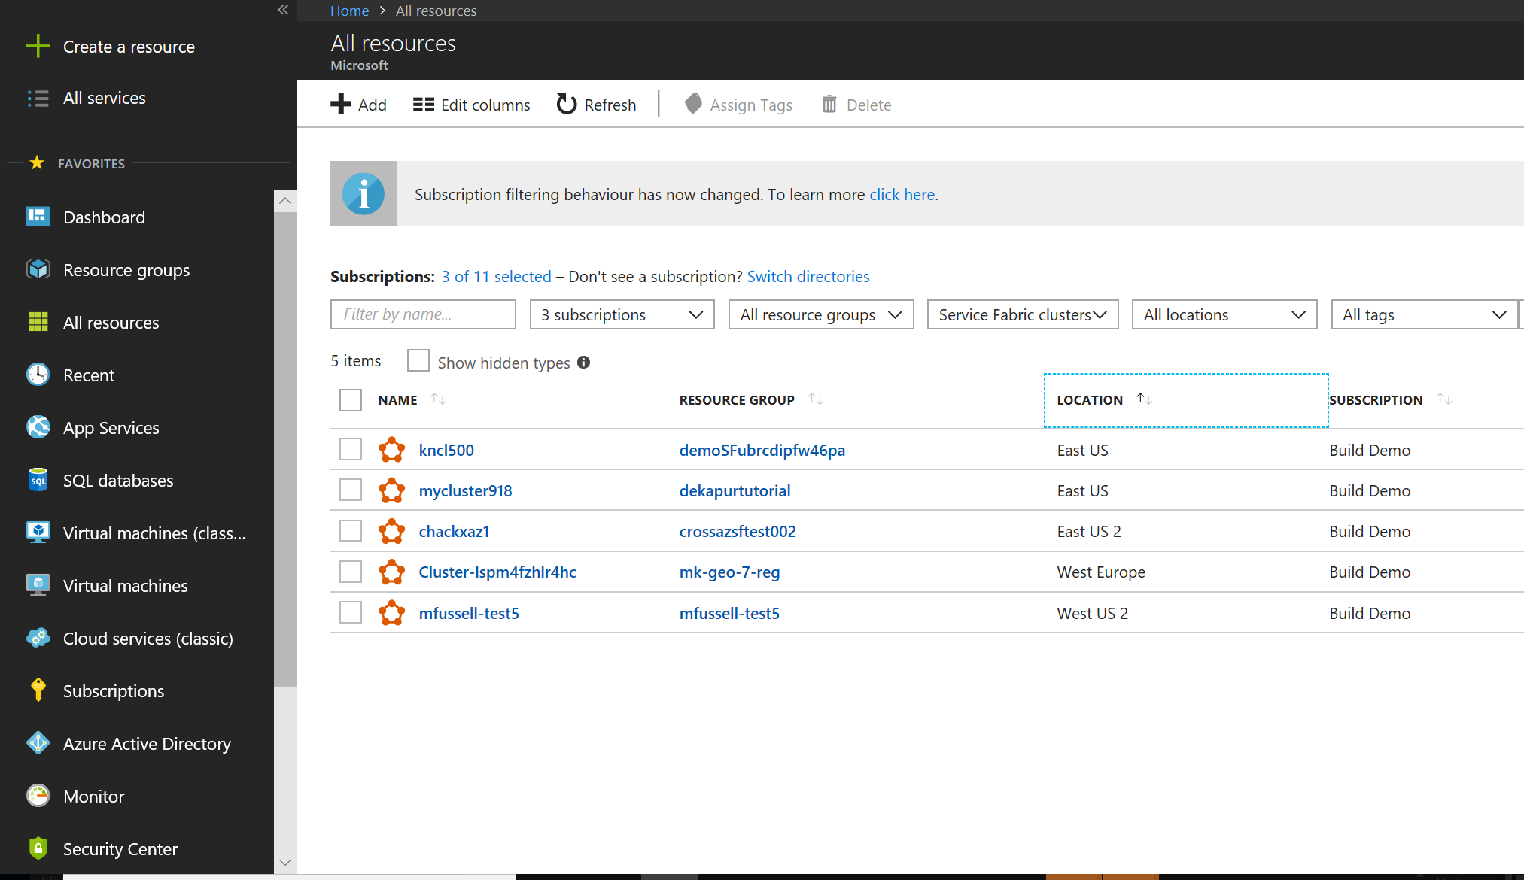

Additional Roadmap Items
Manage both on-premises and Azure clusters in the portal
Managing both stand alone and Azure SF clusters in the portal
Service Fabric Secret Store Service – allows agnostic secret storage with rich API support. Has strong integration with Azure Key Vault
Standalone cluster package generated for Windows or Linux and deployed on-premises
{
104.5.34.98
107.5.34.96
96.4.98.108
}
Any cloud
On-premises
Upload to Azure
Cluster configuration
Service Fabric Standalone Cluster
Azure Service Fabric Cluster

Slide 55
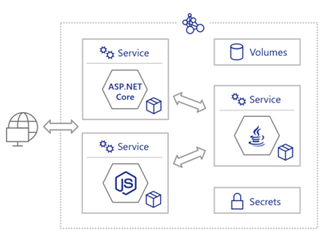
The Future of Service Fabric
Polyglot Services
Described by Service Fabric Resources
Enhanced through Reliable Collections
Connected Through intelligent routing
Service Fabric
Dev Machine
Any Cloud
On-Prem
Azure Clusters
Mesh

Slide 56

Questions?
Feedback:
Kevin Sauer
kesauer@Microsoft.com
Twitter: @3tornados
LinkedIn: https://www.linkedin.com/in/3tornados/
Lynn Orrell
lyorrell@Microsoft.com
Twitter: @lynn_orrell
LinkedIn: https://www.linkedin.com/in/lynn-orrell-304bb21/
Github: /CodingWithSasquatch/Codeslinger-ServiceFabric

Slide 57

Service Fabric Hackathon

Slide 58
Scenario 1: Microservices and Container
Node Type – Front End
Build the scenario out on the right
Challenge:
Using Visual Studio Construct an application that defines all the stateless and container services in the illustration
Challenge:
Set up the Cluster to resemble what is in the picture
Deploy the application into the cluster
Core concepts:
Node Types
Placement constraints
Autoscaling
Service Affinity
VMSS1
Node Type – Back End
VMSS2
Notes:
Build this out – in Visual Studio and/or Azure
2 node types on the same VNET but different subnets with NSGs restricting traffic between services
Each node type will have separate load balancers
Each node type will be an independent VMSS with different machine profiles
The service fabric services can run like this or in an independent 3rd node type marked as “primary”
Service definitions (all stateless microservices or containers):
Pine tree = -1 instances with node placement of “Front End”
Cow = 3 instances, node_type = “Front End”
Lock = -1 instances
Motorcycle = -1 instances with node_type = “Front End”
Football = 7 instances
Turtle = 1 instance
Labrador = -1 instances with node_type = “Back End”
Duck = -1 instances with node_type = “Back End”
Sun = 3 instances with node_type=“back end” with a Parent Affinity for the cloud service
Cloud = 3 instances with node_type = “back end” with a child affinity for the sun service
Rabbit = start with 1 container instance with autoscaling based on load with node_type = “back end”
https://docs.microsoft.com/en-us/azure/service-fabric/service-fabric-cluster-resource-manager-advanced-placement-rules-affinity
https://docs.microsoft.com/en-us/azure/service-fabric/service-fabric-cluster-resource-manager-autoscaling
https://blogs.msdn.microsoft.com/ncdevguy/2017/11/30/service-fabric-auto-scaling-your-service-fabric-cluster-part-i/

Slide 59
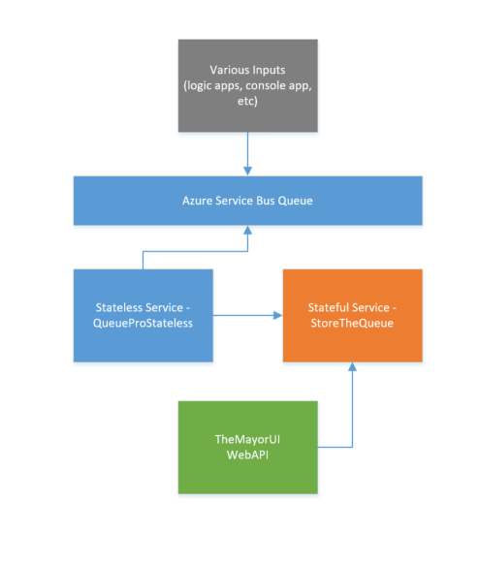
Scenario 2: IoT Processor
Create an Azure Queue and write sample “events”
Stateless service retrieves data from the queue and writes it to Azure SQL
Optionally create a stateful service and move data from queue to SF stateful service. Then on to persistent data store
Test upgrading app live

Slide 60
Scenario 3: Build a Bot
Use the v4 Bot framework template in Visual Studio to create an echo bot
Containerize it
Deploy into a Service Fabric Cluster

Slide 61
DevOps in the Cloud
Prerequisites
Azure CLI
To create your service fabric cluster in Azure
VSTS Release and Build
Create a new VSTS project to manage build and release pipelines
Challenge - Deploy to Azure
Description
Provision a Service Fabric cluster in Azure. Pick an operating system that matches your development environment
Deploy the application running 3 instances of the xtoph/nginx:v2 container using the sfctl CLI
Success Criteria
Service Fabric explorer in the browser from an Azure URL
Challenge - Deploy using a VSTS Release
Production applications rarely deployed from the CLI. Production uses CI/CD pipelines. Let's build a VSTS build/release pipeline to deploy the application into the cluster. In a real production environment, we'd build the container images, but for this challenge, we'll keep things simple and only deploy existing images.
Success Criteria
Service Fabric Explorer shows 2 deployed applications, with 3 replicas each
CI/CD Application Name includes the VSTS build number
Application is accessible via Azure URL
Notes:
https://github.com/xtophs/containers-intro/blob/master/Day2/labs/service-fabric-basics/local-dev-deploy-scale-update.md
https://github.com/xtophs/containers-intro/blob/master/Day2/labs/service-fabric-devops/azure-vsts.md

Slide 62
Setting up Local Development
One of the benefits is developing locally on your machine. On Windows, that allows for a great debugging experience allowing F5 debugging with Visual Studio and Eclipse for native applications.
In these challenges you will:
set up a development environment on your local machine
deploy a containerized application into your cluster
experience the resilience of service fabric applications
Challenge 1
Setup your local dev box, either on Windows, Mac or Linux.
Success Criteria
sfctl is connected to the cluster
Service Fabric explorer displays in the browser from http://localhost:19080/Explorer.
Challenge 2 - Deploying an Application
Windows Deploy a containerized application running a single instance of the xtoph/webapp:1.0.0 container into your local environment. The webapp listens on port 5000. Make sure you configure Service Fabric to map the port.
Linux Deploy a containerized application running a single instance of the xtoph/nginx:v1 container into your local environment. Nginx listens on port 80. Make sure you configure Service Fabric to map the port.
Success Criteria
The application shows deployed in Service Fabric explorer
Windows The MVC home page shows in your browser when accessed via the cluster DNS name
Linux The NGINX index page shows in your browser when accessed
Verify that it survives and "application crash" and update the application to the new version.
Challenge 3 - No Downtime Changes
Using the sfctl CLI increase the number of instances of the xtoph/nginx:v1 container from 1 to 3. Then update the version from windows xtoph/webapp:1.0.0 to xtoph/webapps:2.0.0 Linux xtoph/nginx:v1 to xtoph/nginx:v2.
Watch the Service Fabric explorer during update and scale operations
Success criteria
3 running instances of the Service displayed in Service Fabric explorer
Browser shows windows MVC Version 2 page or Linux xtoph/nginx:v2 welcome page
Notes:
https://github.com/xtophs/containers-intro/blob/master/Day2/labs/service-fabric-basics/local-dev-deploy-scale-update.md
https://github.com/xtophs/containers-intro/blob/master/Day2/labs/service-fabric-devops/azure-vsts.md

